Slide 1
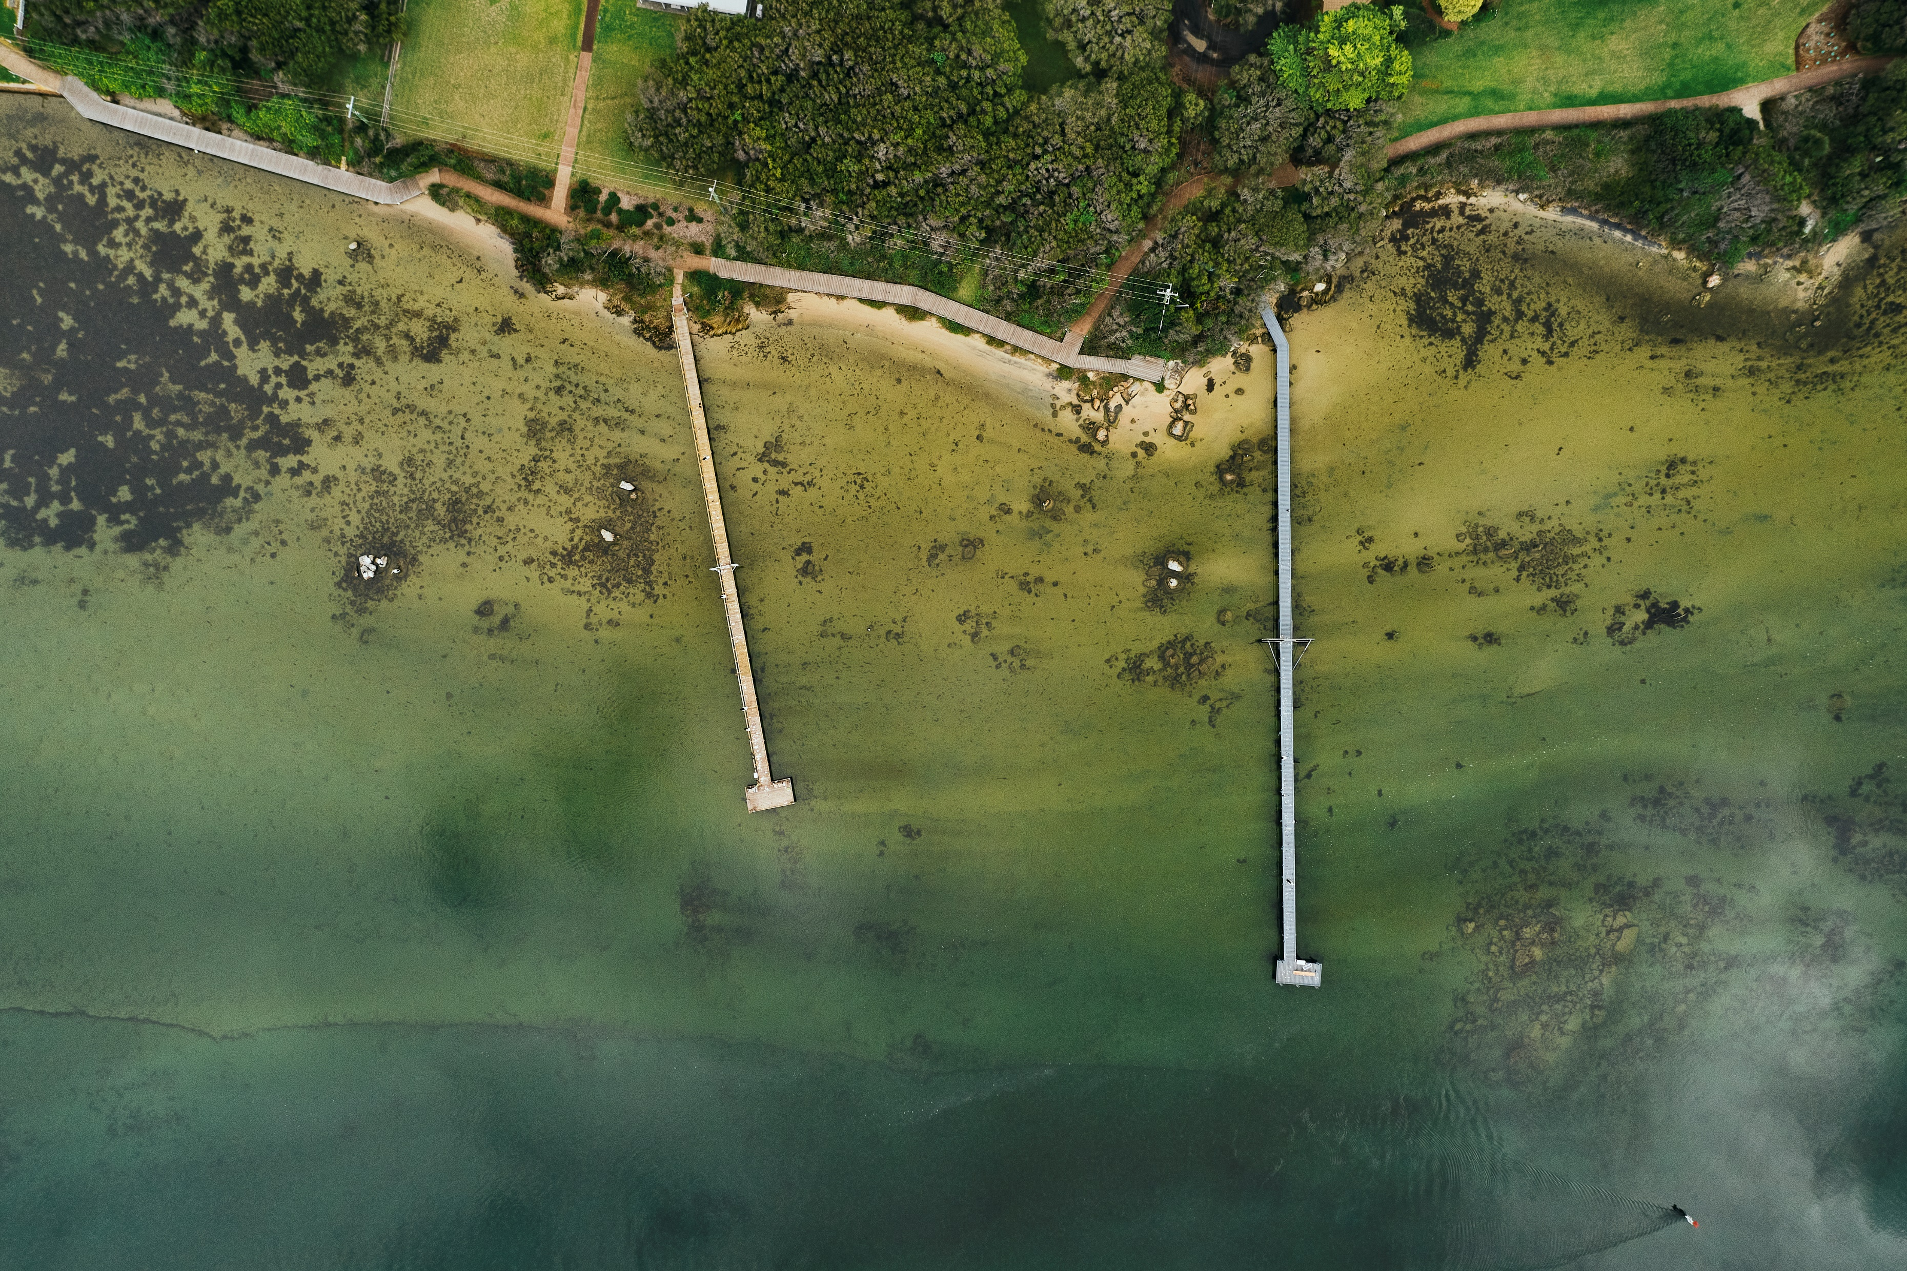


Local Biodiversity Strategy
July 2025 - Session 3c
Notes:
Mainstream biodiversity in Shire operations and decision making
Thank you for your interest in the Shire of Augusta Margaret River’s draft Local Biodiversity Strategy. This slideshow is part of our third community consultation session on the draft strategy, and covers the sixth and last key area – Mainstreaming biodiversity in Shire operations and decision making.
In this final section of the Strategy, we shift focus to a critical area: how we incorporate biodiversity protection into the core of our own operations.
This section — Mainstreaming Biodiversity in Shire Operations and Decision-Making — is about ensuring that biodiversity is a core principle that guides decision making in all of our areas including resourcing, infrastructure development, maintenance, planning, staff training, and compliance.
Objective: Incorporate biodiversity protection principles in all levels of Shire decision-making and operations.

Slide 2
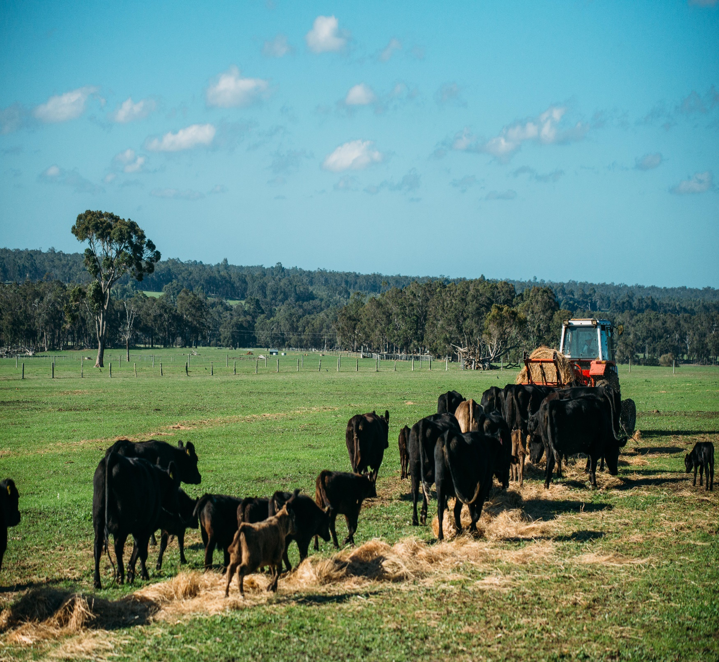
The Local Biodiversity Strategy: What does it try to do?
Guide the protection, enhancement and management of local natural areas across the Shire.
Specifically, improve how biodiversity is considered in:
Shire operations;
Supporting community, stakeholders and landholders in biodiversity initiatives.
Notes:
Go straight to actions.

Slide 3
The six Strategies for high priority LNA’s?
(A) Protect the existing LNAs
(B) Improve the existing LNAs
(D) Work with partners
(E) Foster community understanding, respect and stewardship for the environment
(F) Mainstream biodiversity in Shire operations and decision making
(C) Protection and enhance links between LNAs
A 10 year program ….
Notes:
I can’t recall who we said was going to be delivering this? Hayley? Gina? – This was most likely Hayley. Happy to do it if not.
Go straight to actions.

Slide 4
Part 2: Strategy F: Mainstream Biodiversity in Shire Operations and decision making
(F) Mainstream Biodiversity in Shire Operations and decision making
Funding and Resourcing
Governance
A plant local first approach
Shire processes and training
Regulation and Enforcement

Slide 5
Part 2: Strategy F
(F) Mainstream Biodiversity in Shire Operations and decision making
Funding and Resourcing
Governance
A plant local first approach
Shire processes and training
Regulation and Enforcement
Assess funding requirements to implement this strategy, and apply for grant funding to costs
Review the Actions and whole Strategy regularly to check progress and update to make current.
Implement a Shire wide approach landscaping using local native species..
Implement biodiversity training for staff and annual planting days.
Assess risk to biodiversity during Shire construction and maintenance works.
Implement best practice weed hygiene management in Shire managed areas
Review Shire resourcing for compliance, including illegal clearing and encroachments into Shire LNAs

Slide 6

Questions and Answers: Part 2 – Strategy F
Please write some questions you have about the above material we have covered at the link provided on the Your Say page.
Notes:
Tables come up with questions as a group then a spokesperson to ask it on behalf of the table.

Slide 7

What is your level of agreement with this part of the Plan?
Can you ‘live’ with this part?
If not, what would it take to get to a place where you could?
Notes:
Tables come up with questions as a group then a spokesperson to ask it on behalf of the table.

Slide 8
Thank you

