Slide 1
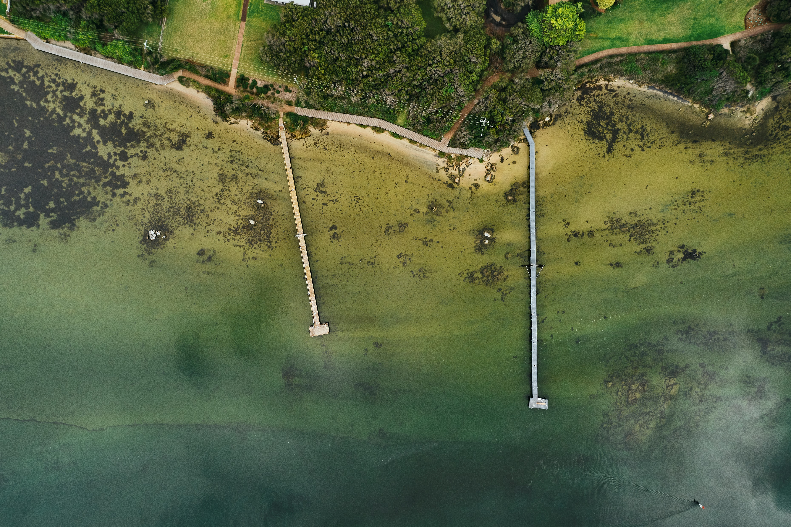


Local Biodiversity Strategy
July 2025 - Session 3a
Notes:
Working with Partners
Thank you for your interest in the Shire of Augusta Margaret River’s draft Local Biodiversity Strategy. This slideshow is part of our third community consultation session on the draft strategy, and covers the fourth key area – Working with our partners.
This section of the Strategy is about working collaboratively with our partners and the community to building a stronger, more connected network of people and groups that value and actively cares for our local natural areas.
It aims to optimise community engagement, create opportunities for advocacy, and build meaningful partnerships. By working alongside community members, landholders, and our stakeholders, we can better protect and restore our local natural areas, which are vital for biodiversity to thrive into the future.
This isn’t new in our community. There is a strong history community working together on environmental initiatives. The draft strategy identifies where we can continue to build partnership and find opportunities through grants, partnership projects and advocacy to optimise our overall efforts in this space.

Slide 2
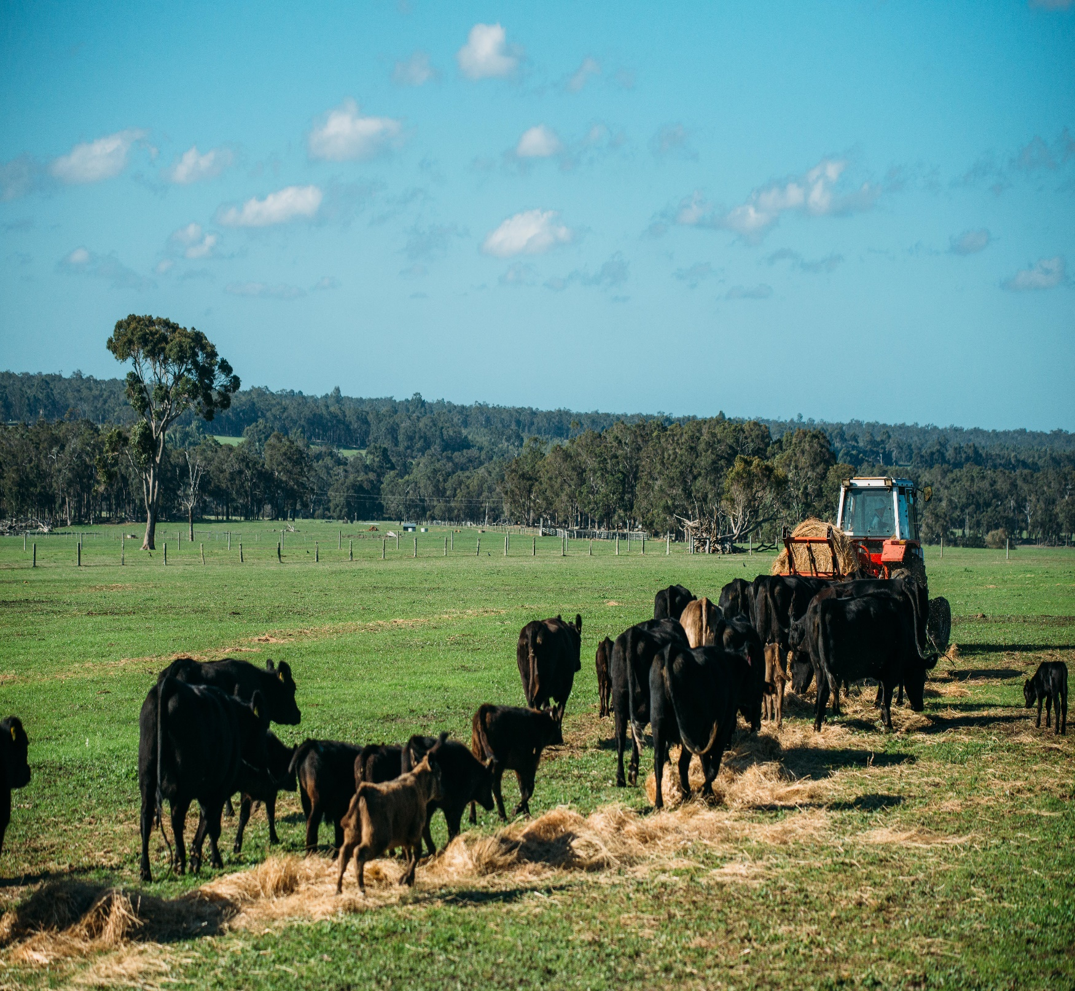
The Local Biodiversity Strategy: What does it try to do?
Guide the protection, enhancement and management of local natural areas across the Shire.
Specifically, improve how biodiversity is considered in:
Shire operations;
Supporting community, stakeholders and landholders in biodiversity initiatives.
Notes:
Go straight to actions.

Slide 3
The six Strategies for high priority LNA’s?
(A) Protect the existing LNAs
(B) Improve the existing LNAs
(D) Work with partners
(E) Foster community understanding, respect and stewardship for the environment
(F) Mainstream biodiversity in Shire operations and decision making
(C) Protection and enhance links between LNAs
A 10 year program ….
Notes:
I can’t recall who we said was going to be delivering this? Hayley? Gina? – This was most likely Hayley. Happy to do it if not.
Go straight to actions.

Slide 4
Part 2: Strategy D: How does it try to do it?
(D) Working with Partners
Aboriginal Cultural Heritage
Friends of Reserves
NRM, Cultural and Community organisations
Tourism
Strategic Partnerships
Advocacy

Slide 5
Part 3: Strategy D: How does it try to do it?
(D) Working with Partners
Aboriginal Cultural Heritage
Friends of Reserves
NRM, Cultural and Community organisations
Tourism
Strategic Partnerships
Advocacy
Build strong relationships with cultural custodians via Shire’s Jenna Yen Mandamung (Walking Together) Strategy
Support and build capacity of Friends groups
Engage with Cultural Ranger Teams on Regeneration Projects, and seek approvals for activities on Registered Aboriginal Heritage Sites
Establish a Friends Volunteer Manual to lay out WHS and other standards.
Support NRM and community groups through grants and funds.
Build on ECO Destination certification.
Work with tourism partners to find opportunities for improving biodiversity.
Partner in Strategic projects like Wooditjup Bilya, Taalyinup Boya, Gondwana Link, and other plans and actions. Support LandCare Nurseries.
Advocate for biodiversity on issues like national recognition of Arum Lilly, State Govt. funding for Leeuwin Naturaliste National Park.

Slide 6
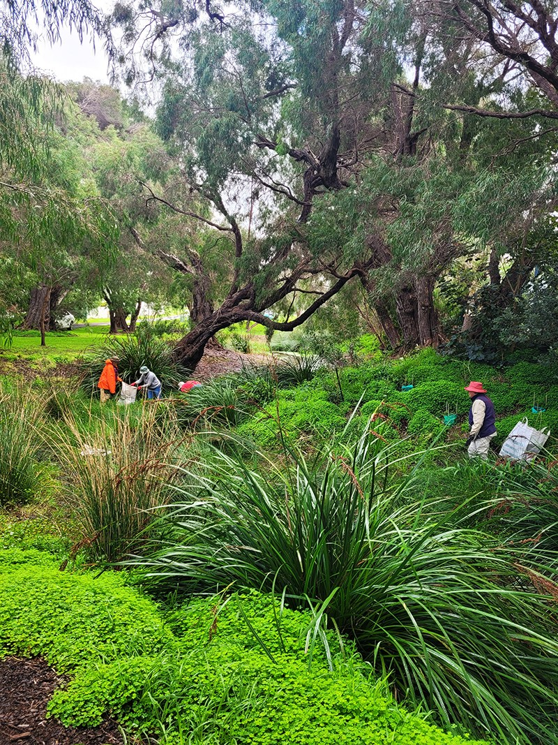

Slide 7
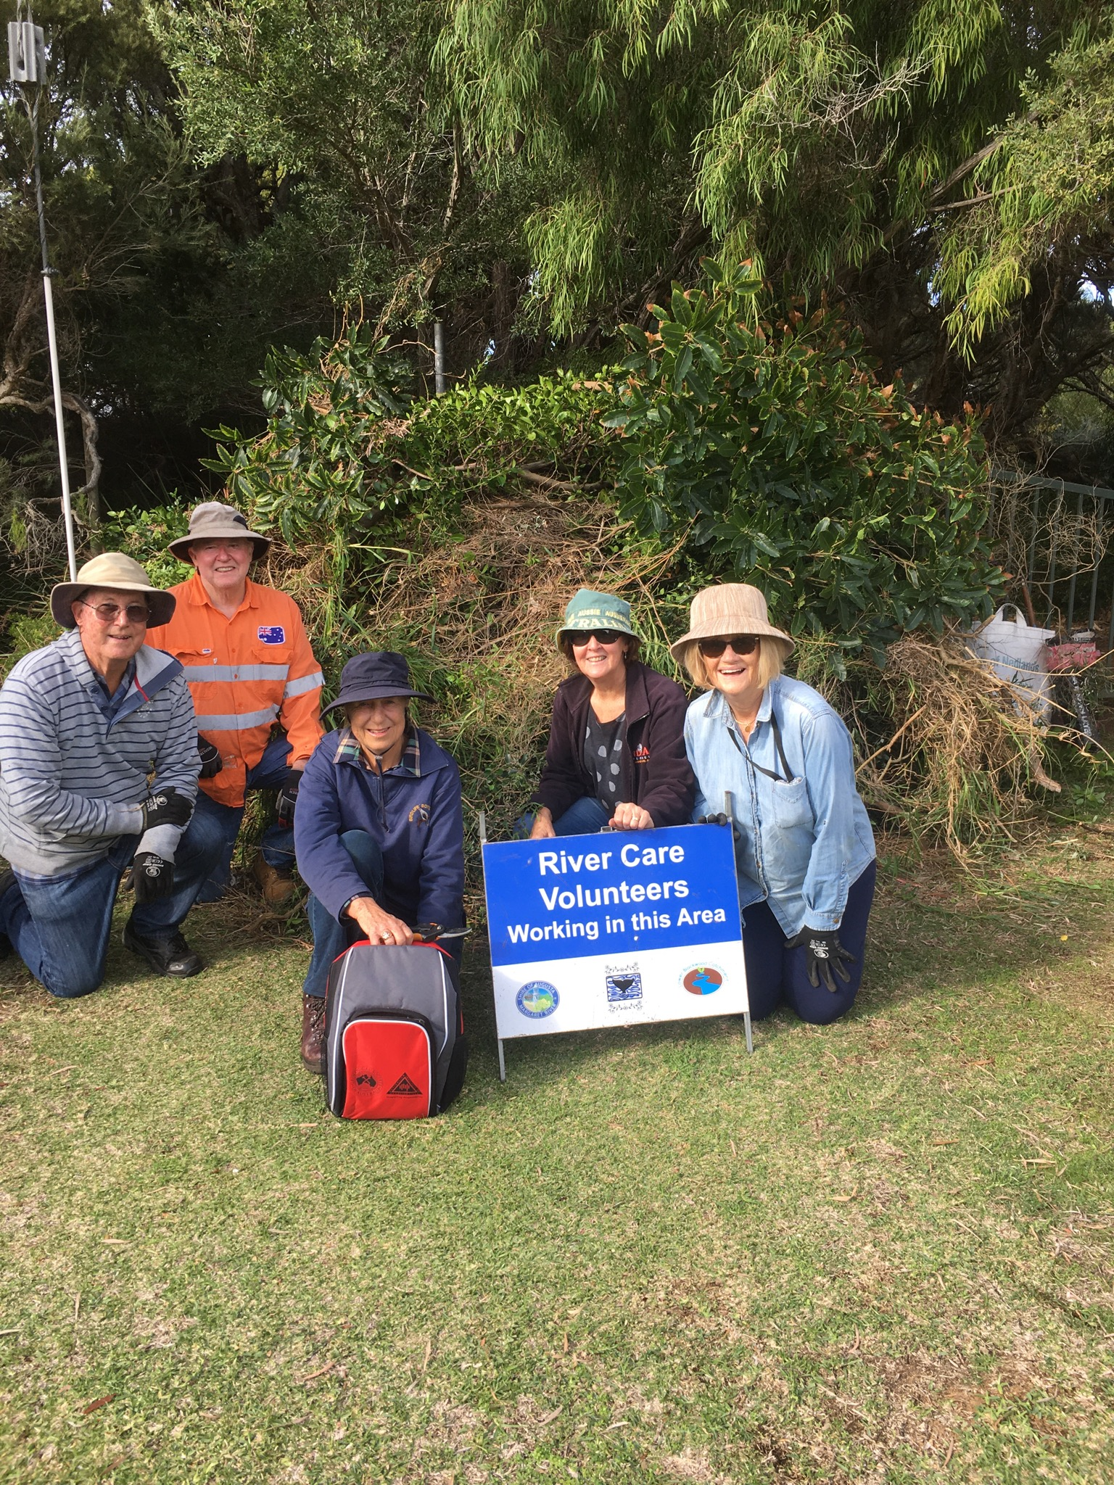

Slide 8
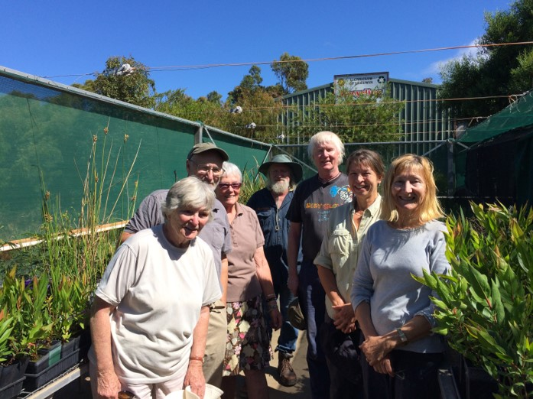

Slide 9
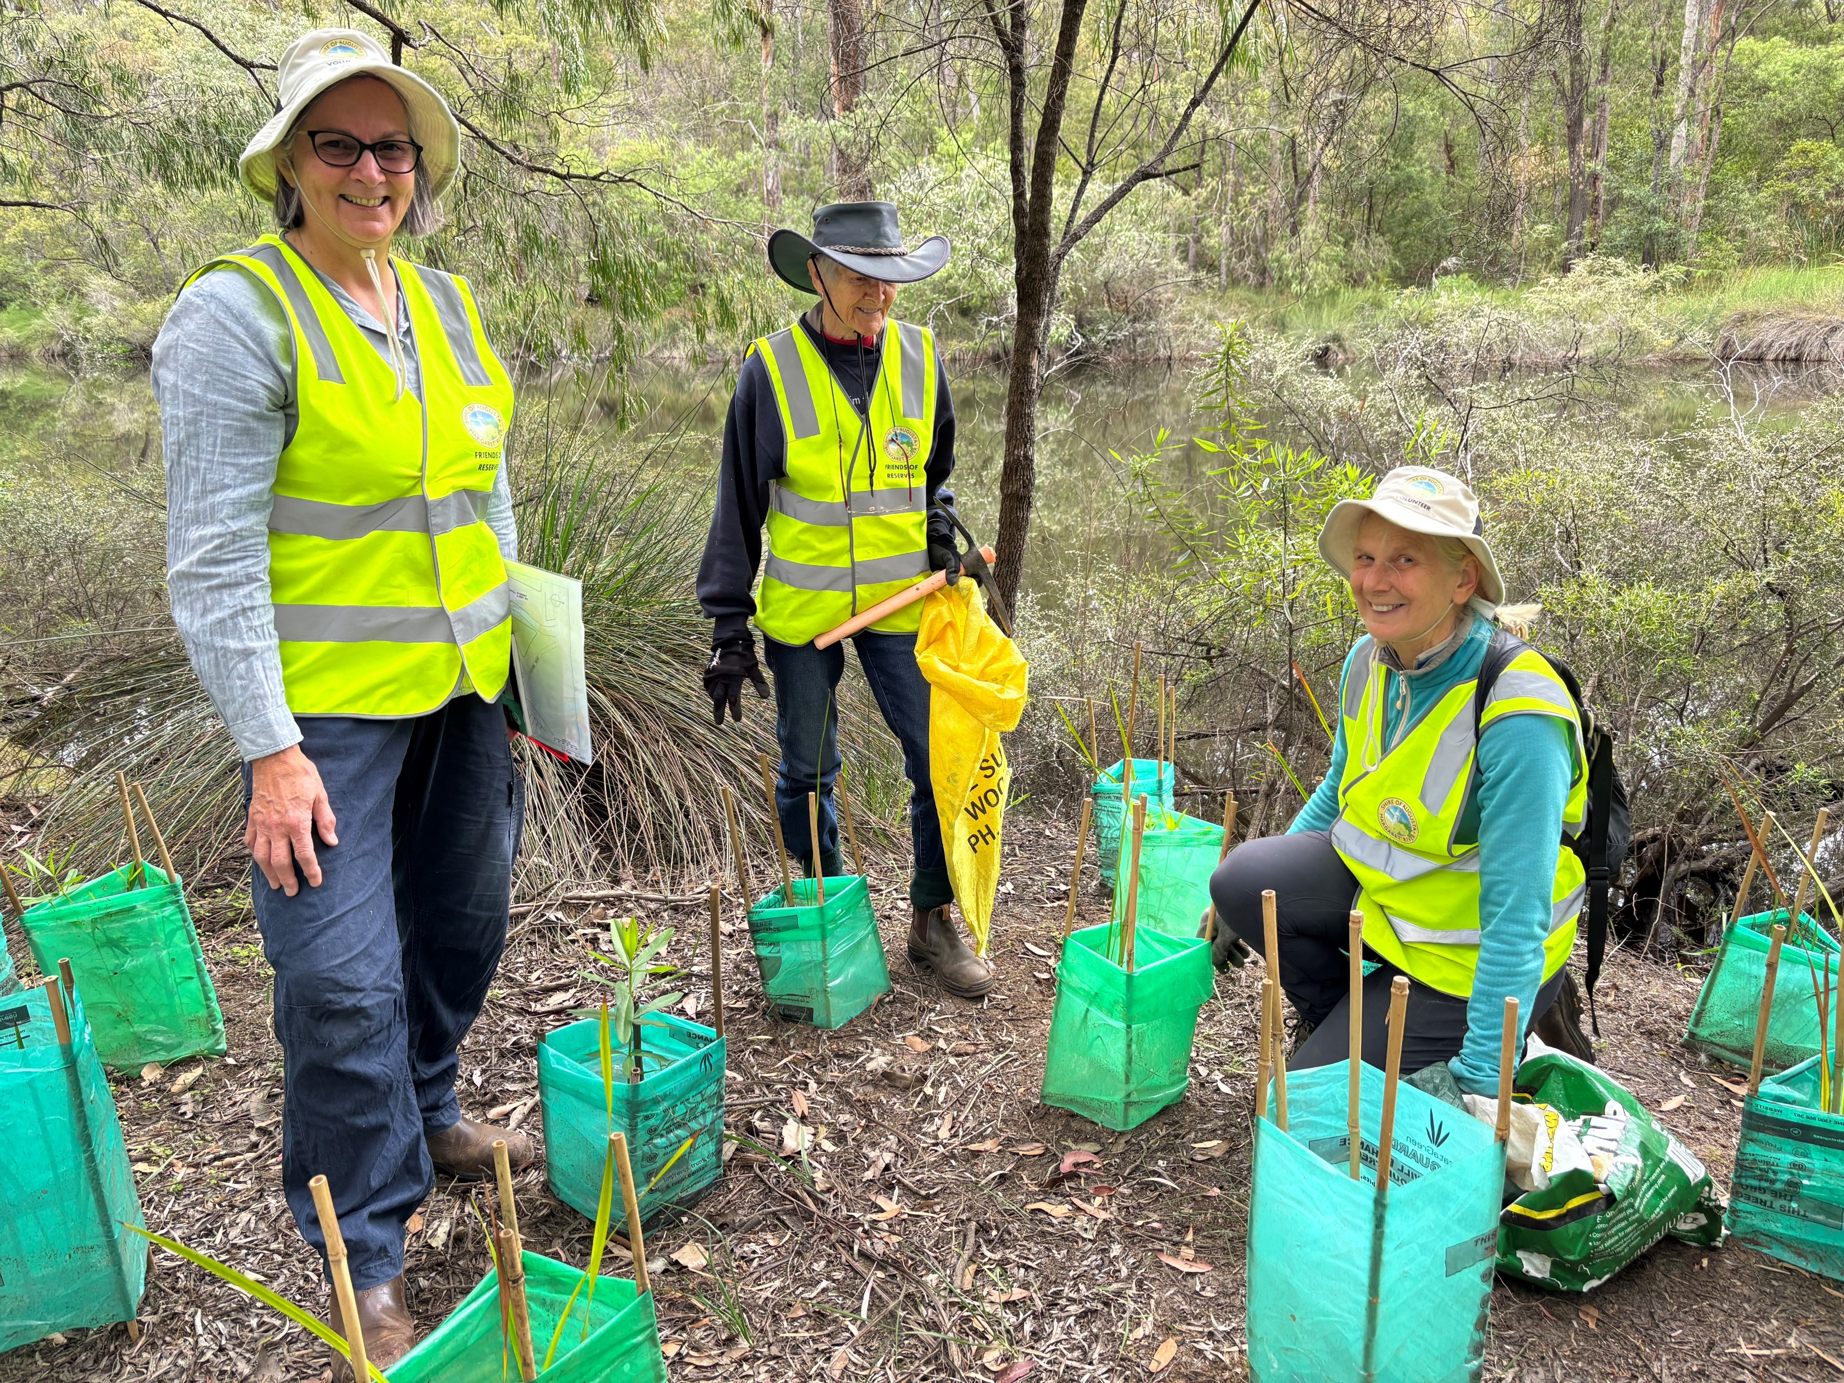

Slide 10
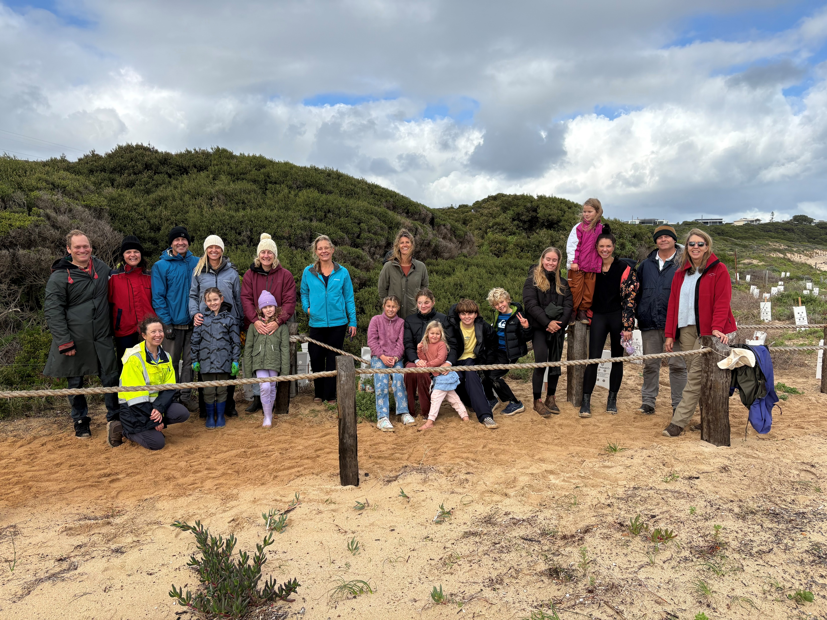

Slide 11
Part 3: Strategy D: How does it try to do it?
(D) Working with Partners
Aboriginal Cultural Heritage
Friends of Reserves
NRM, Cultural and Community organisations
Tourism
Strategic Partnerships
Advocacy
Build strong relationships with cultural custodians via Shire’s Jenna Yen Mandamung (Walking Together) Strategy
Support and build capacity of Friends groups
Engage with Cultural Ranger Teams on Regeneration Projects, and seek approvals for activities on Registered Aboriginal Heritage Sites
Establish a Friends Volunteer Manual to lay out WHS and other standards.
Support NRM and community groups through grants and funds.
Build on ECO Destination certification.
Work with tourism partners to find opportunities for improving biodiversity.
Partner in Strategic projects like Wooditjup Bilya, Taalyinup Boya, Gondwana Link, and other plans and actions. Support LandCare Nurseries.
Advocate for biodiversity on issues like national recognition of Arum Lilly, State Govt. funding for Leeuwin Naturaliste National Park.
Notes:
As custodians of their farms, local farmers and viticulturists are experimenting with ways to increase biodiversity, capture carbon, retain water, and grow the healthiest produce possible. The Shire is proud to support the amazing work being done by the Margaret River Wine Association with their Sustainable Wine Growing program. The Shire is also a proud supporter of Lower Blackwood LCDC, whose work is improving sustainability from the ground up.

Slide 12
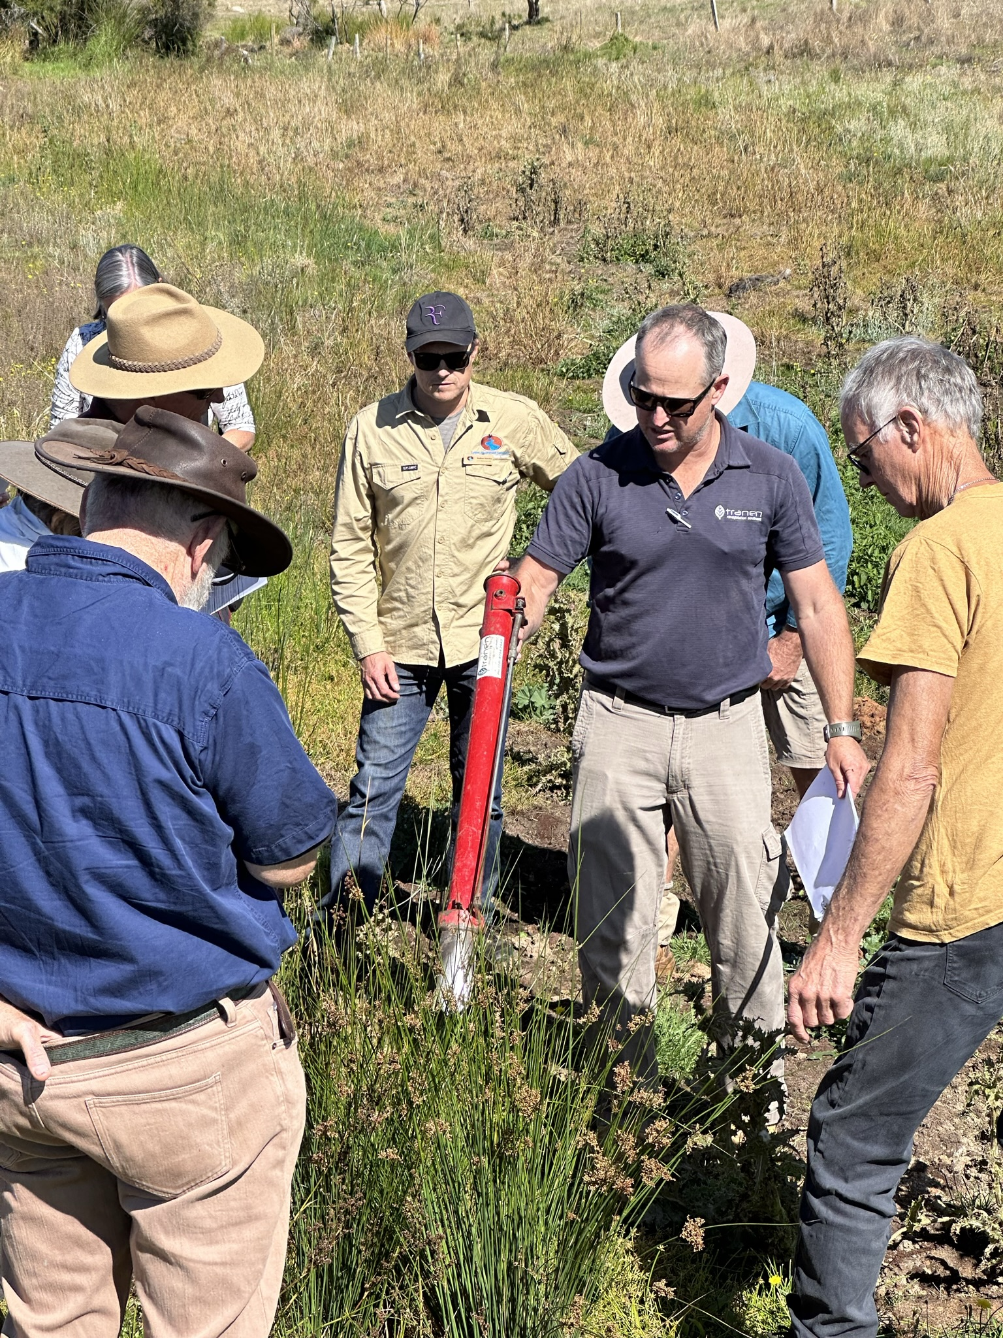

Slide 13
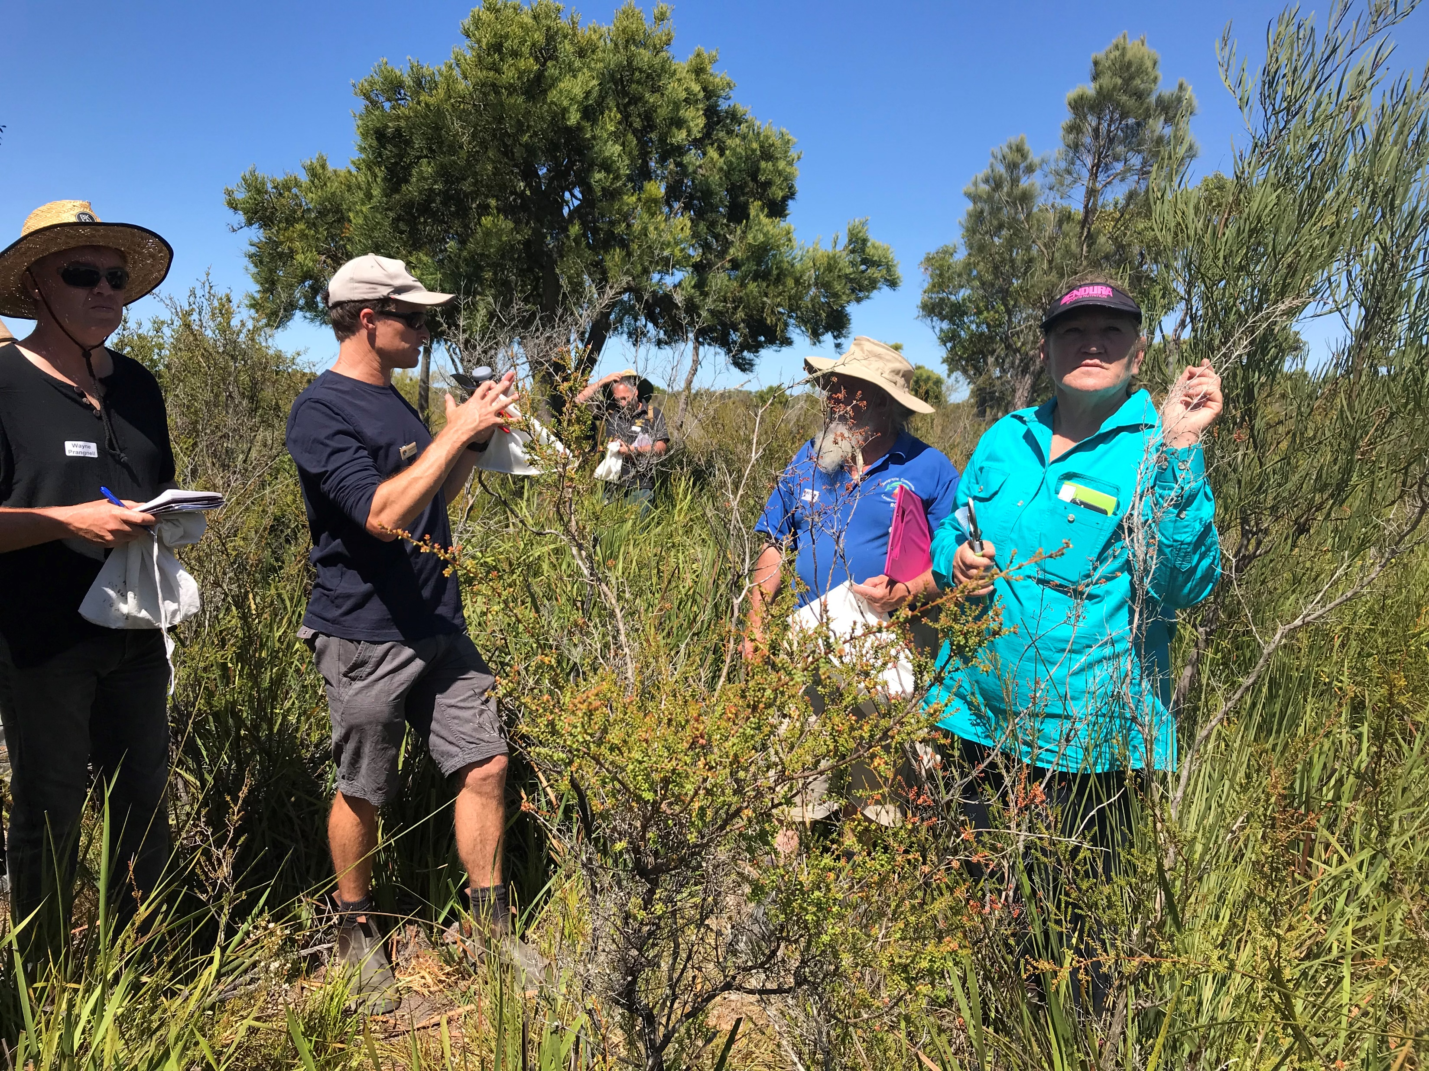

Slide 14
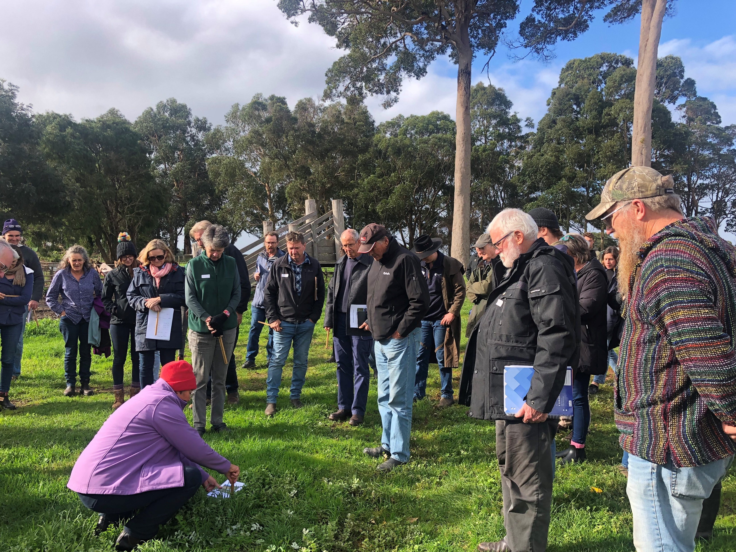

Slide 15
Part 3: Strategy D: How does it try to do it?
(D) Working with Partners
Aboriginal Cultural Heritage
Friends of Reserves
NRM, Cultural and Community organisations
Tourism
Strategic Partnerships
Advocacy
Build strong relationships with cultural custodians via Shire’s Jenna Yen Mandamung (Walking Together) Strategy
Support and build capacity of Friends groups
Engage with Cultural Ranger Teams on Regeneration Projects, and seek approvals for activities on Registered Aboriginal Heritage Sites
Establish a Friends Volunteer Manual to lay out WHS and other standards.
Support NRM and community groups through grants and funds.
Build on ECO Destination certification.
Work with tourism partners to find opportunities for improving biodiversity.
Partner in Strategic projects like Wooditjup Bilya, Taalyinup Boya, Gondwana Link, and other plans and actions. Support LandCare Nurseries.
Advocate for biodiversity on issues like national recognition of Arum Lilly, State Govt. funding for Leeuwin Naturaliste National Park.
Notes:
An ECO Destination is a globally recognised destination that has an outstanding natural environment and best practice management. This certification ensures a strong commitment to manage our place sustainably and support nature-based tourism experiences within the region.
The Shire has made solid steps to achieve certification as an ECO Destination, protecting the natural environment and quality of life for our community and visitors alike.

Slide 16

Questions and Answers: Part 2 – Strategy D
Please write some questions you have about the above material we have covered at the link provided on the Your Say page.
Notes:
Tables come up with questions as a group then a spokesperson to ask it on behalf of the table.

Slide 17

What is your level of agreement with this part of the Plan?
Can you ‘live’ with this part?
If not, what would it take to get to a place where you could?
Notes:
Tables come up with questions as a group then a spokesperson to ask it on behalf of the table.

Slide 18
Thank you

