Slide 1
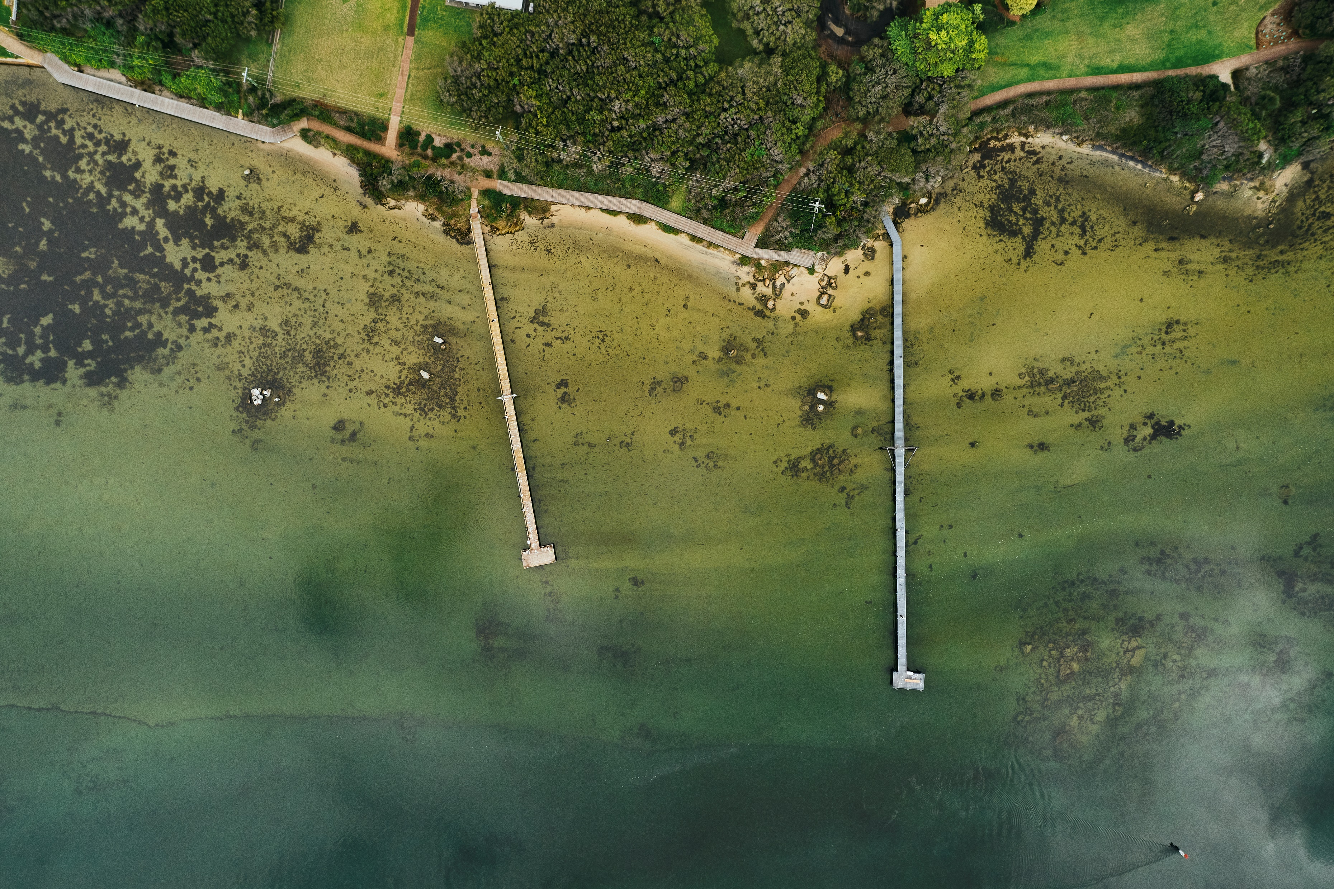


Local Biodiversity Strategy
July 2025 - Session 3b
Notes:
Foster Community understanding, respect and stewardship for the environment
Thank you for your interest in the Shire of Augusta Margaret River’s draft Local Biodiversity Strategy. This slideshow is part of our third community consultation session on the draft strategy, and covers the fifth key area – Fostering community understanding, respect and stewardship for the environment
A key part of the strategy is providing meaningful engagement and knowledge sharing opportunities for our community. We want to empower people with knowledge, to help foster a stronger sense of environmental awareness, stewardship, and respect for our local environment.
This is on the basis that when people understand the value of biodiversity and feel connected to it, they’re far more likely to take action to protect it. This could look like on-ground projects, local workshops, information resources, school programs, or citizen science initiatives.
Objective: Provide education and engagement opportunities for the community to foster a sense of environmental awareness, stewardship and respect.

Slide 2
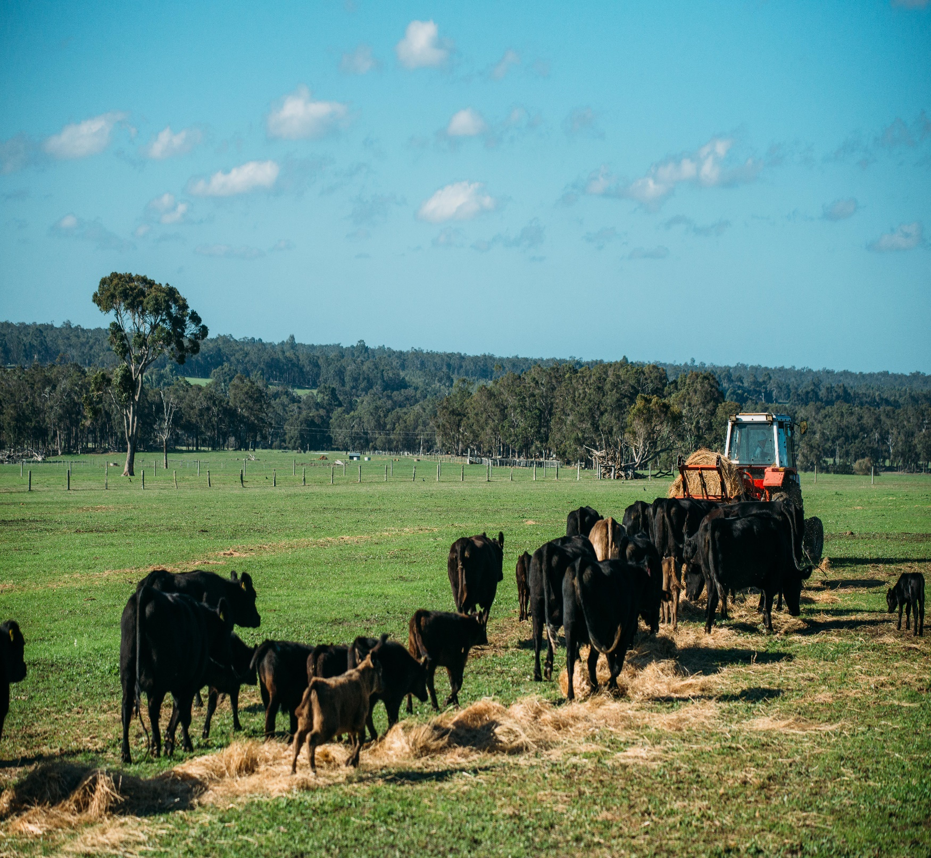
The Local Biodiversity Strategy: What does it try to do?
Guide the protection, enhancement and management of local natural areas across the Shire.
Specifically, improve how biodiversity is considered in:
Shire operations;
Supporting community, stakeholders and landholders in biodiversity initiatives.
Notes:
Go straight to actions.

Slide 3
The six Strategies for high priority LNA’s?
(A) Protect the existing LNAs
(B) Improve the existing LNAs
(D) Work with partners
(E) Foster community understanding, respect and stewardship for the environment
(F) Mainstream biodiversity in Shire operations and decision making
(C) Protection and enhance links between LNAs
A 10 year program ….
Notes:
I can’t recall who we said was going to be delivering this? Hayley? Gina? – This was most likely Hayley. Happy to do it if not.
Go straight to actions.

Slide 4
Part 2: Strategy E: Foster Community Understanding, Respect and Stewardship for the Environment?
(E) Foster Community Understanding, Respect and Stewardship for the Environment
Biodiversity Information Packs
Awareness Raising and Education
Youth
Water Resource Protection

Slide 5
Part 2: Strategy E: Foster Community Understanding, Respect and Stewardship for the Environment
(E) Foster Community Understanding, Respect and Stewardship for the Environment
Biodiversity Information Packs
Awareness Raising and Education.
Youth
Water Resource Protection
Produce a series of Biodiversity Information Packs for new and existing residents/landowners
Recognise achievements of groups and individuals that contribute to improvements to biodiversity.
Improve Shire information on biodiversity and work with partners on relevant biodiversity campaigns
Install demonstration sites to highlight waterwise and habitat-friendly gardens and verges
Produce information sheets on legislative guidance related to biodiversity.
Continue to support NRM groups and schools to engage in educational projects around biodiversity. Support involvement of youth in regeneration projects.
Work with Water Corporation and local residences to improve water use and water wise gardens.

Slide 6
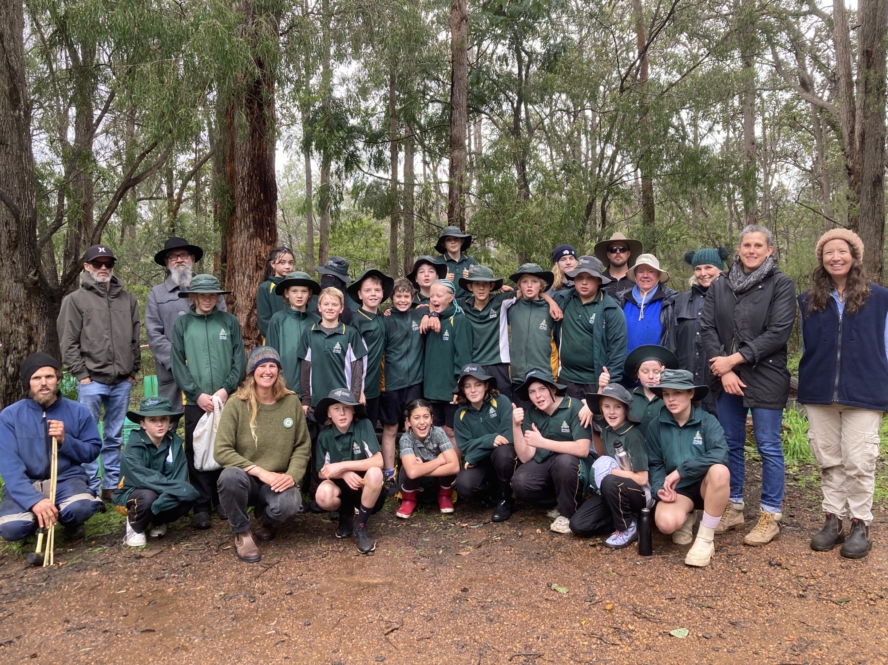

Slide 7

Questions and Answers: Part 3 – Strategy E
Please write some questions you have about the above material we have covered at the link provided on the Your Say page.
Notes:
Tables come up with questions as a group then a spokesperson to ask it on behalf of the table.

Slide 8

What is your level of agreement with this part of the Plan?
Can you ‘live’ with this part?
If not, what would it take to get to a place where you could?
Notes:
Tables come up with questions as a group then a spokesperson to ask it on behalf of the table.

Slide 9
Thank you

